Slide 1


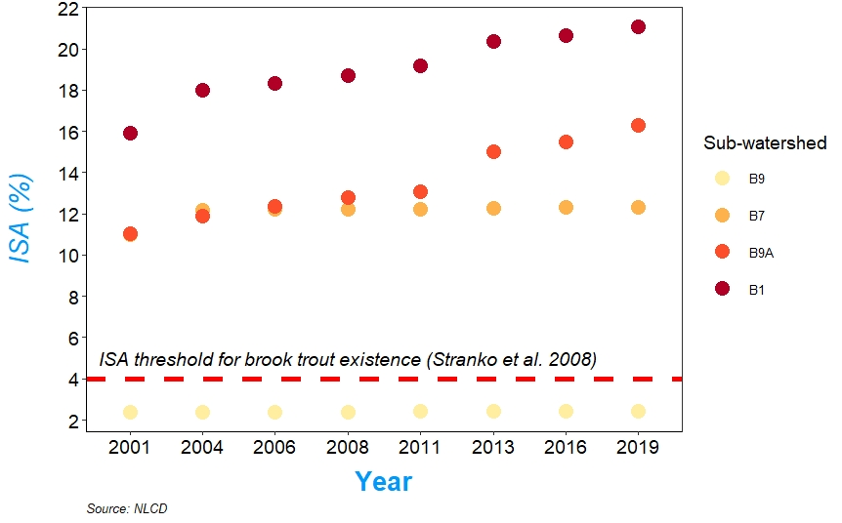
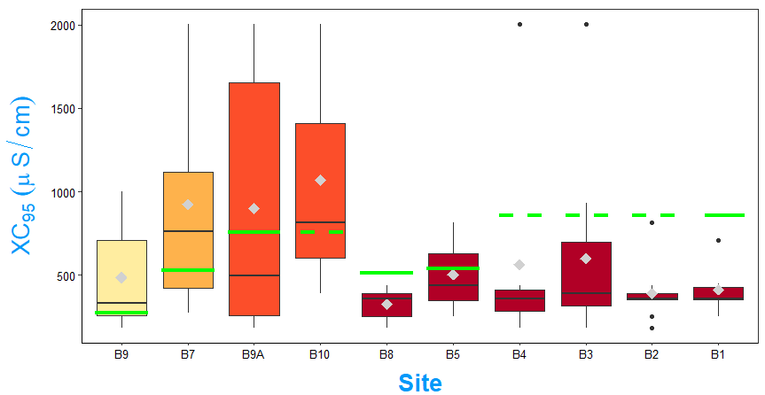
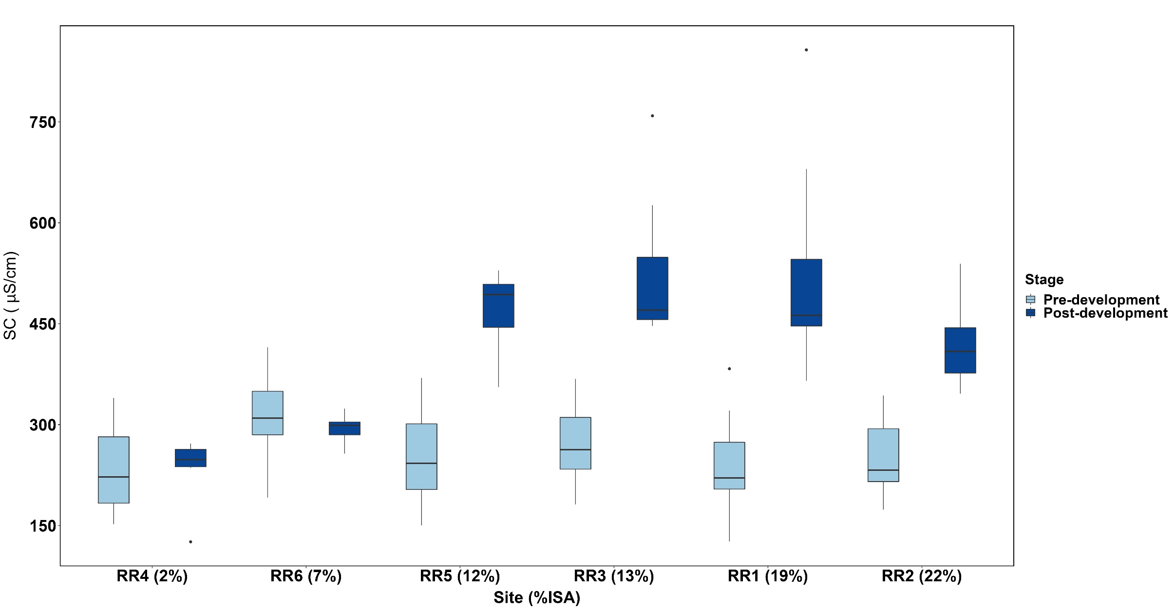
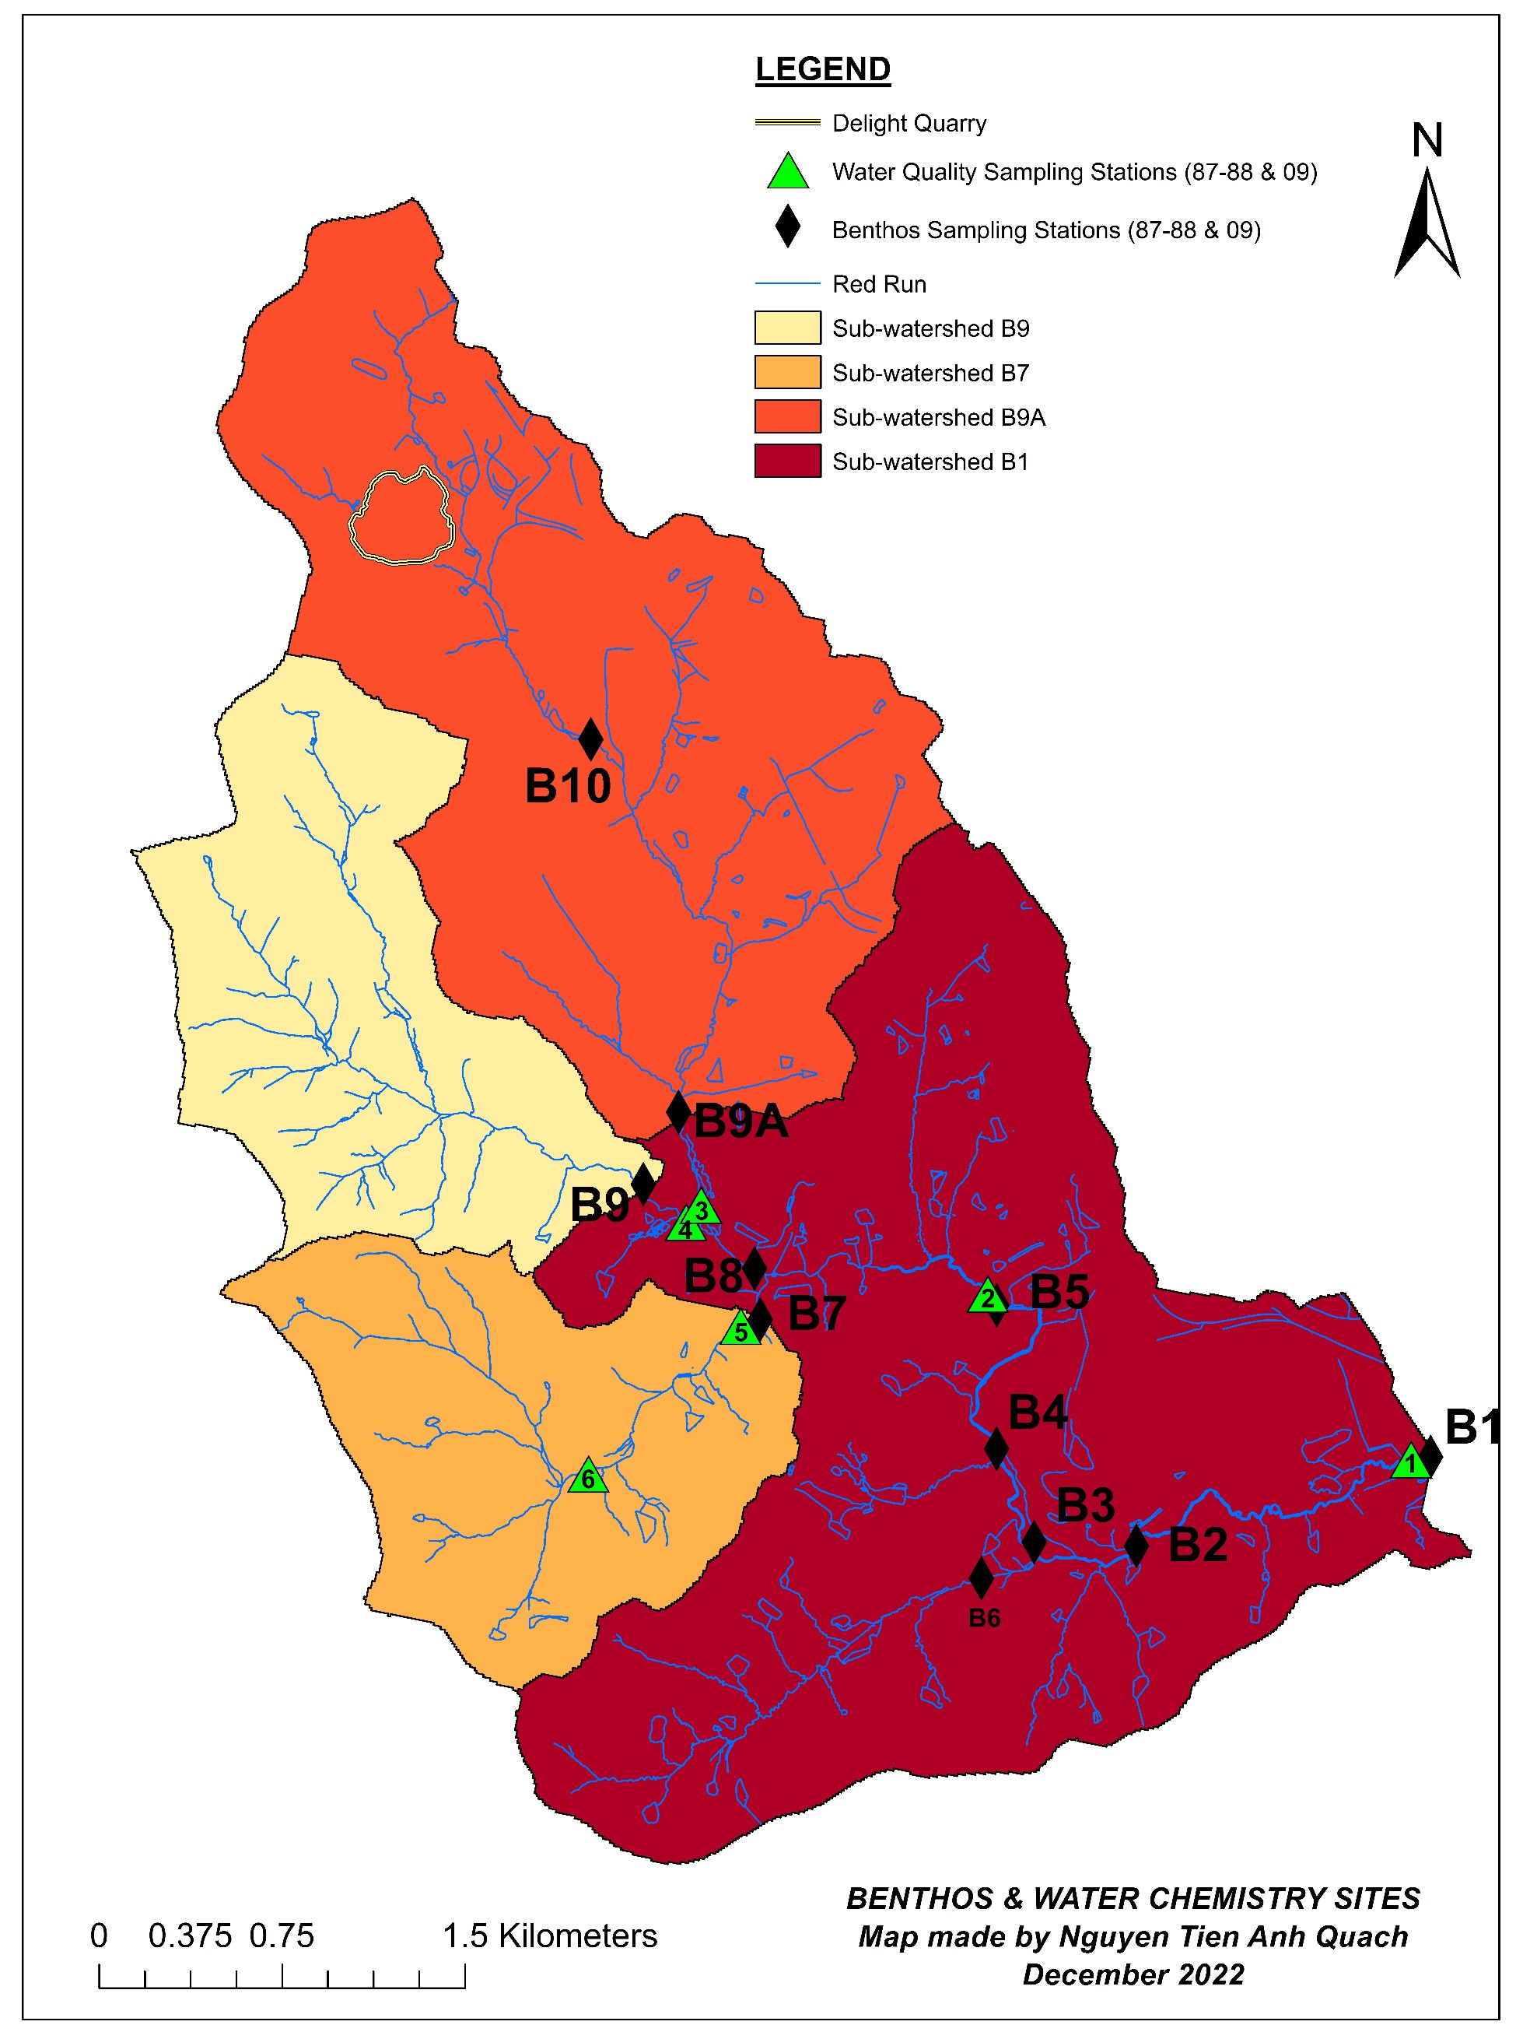
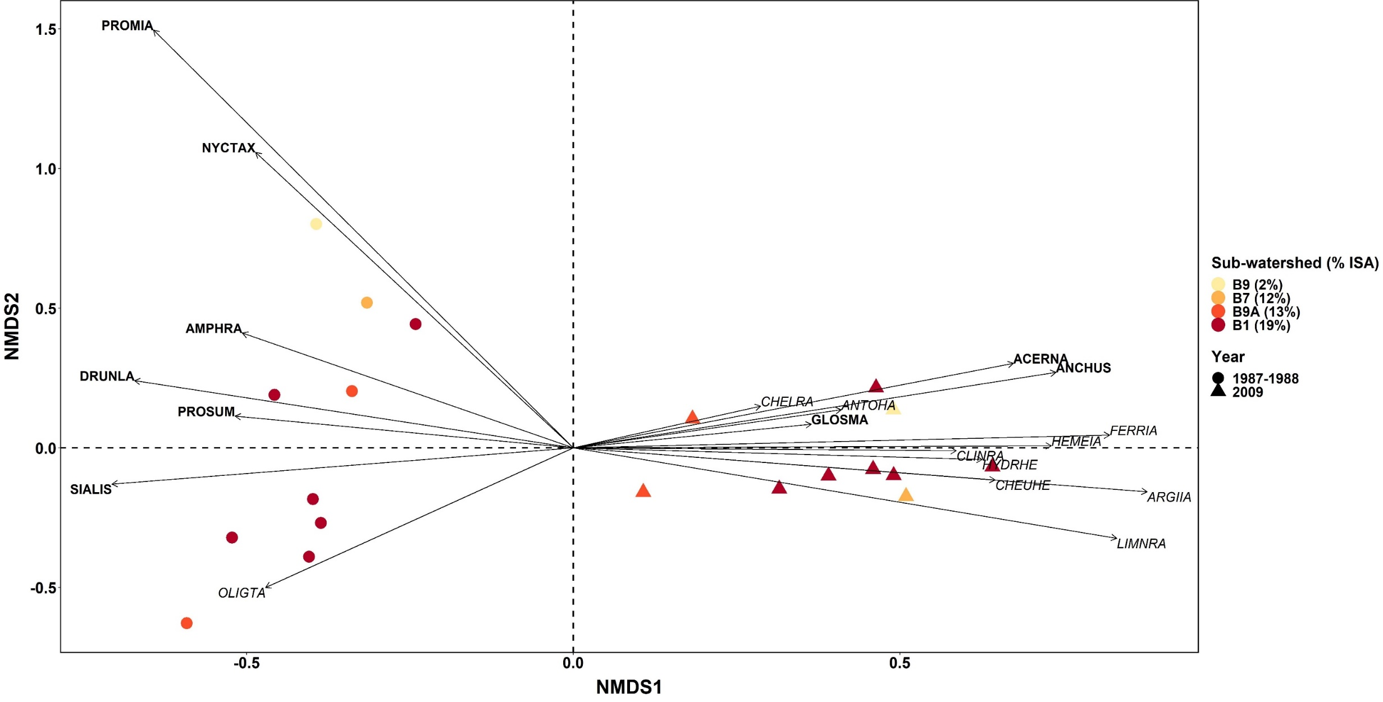
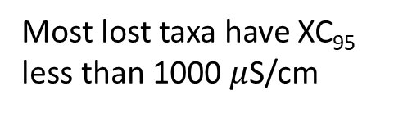
Consequences of Freshwater Salinization for Benthic Macroinvertebrate Communities and Water Chemistry
Nguyen Tien Anh Quach¹, Joel Moore², Susan Gresens¹
¹ Department of Biological Sciences, Towson University; ² Department of Physics, Astronomy, & Geosciences, Towson University
Introduction
Results
The Red Run watershed was predominantly rural in 1987. The Baltimore County Council adopted the Owings Mills Master Plan, in 1984, to create the Owings Mills Town Center¹ and Red Run dam was proposed to be built². An impact assessment of the proposed dam was conducted at ten benthic and six water quality sampling stations chosen by the BC DEPS and U.S. Army Corps of Engineer (Fig. 1). Although the dam proposal was not approved, Red Run watershed experienced rapid residential and commercial development from 1990s to 2000.
Land Cover
Stressor Analysis
Randomization tests: To determine whether lost sensitive taxa were preferentially or randomly lost due to salinity stressor, randomization tests were conducted using the extirpation level of specific conductivity⁴ (XC₉₅) – the level of specific conductance above which only 5% of a benthic macroinvertebrate genus would be observed, for taxa in the Northern Piedmont region of Maryland.
Figure 2. Impervious surface area (ISA) in 4 sub-watersheds from 2001 to 2019. ISA ranged from 2 to 22%, with largest increases in sub-watersheds B1 and B9A. Sub-watershed B9 consistently stayed at 2% ISA, below the threshold for brook trout existence.
Most lost taxa have XC₉₅
less than 1000 $μ$S/cm
Research Questions
1. How did specific conductance and major ion concentrations change over the period of 1987-2009?
2. How did benthic communities respond to rapid urbanization?
3. Which stressor(s) were likely the driving cause of the declines in biotic integrity?
Water Chemistry
Figure 3. Specific conductance (SC) in 1987-1988 and 2009-2010. The concentrations of Cl⁻ and Ca²⁺ and SC had statistically significant correlations with each other (p < 0.001; R² ranged from 0.82 to 0.93).
*
*
*
Methods
Figure 5. XC₉₅ distribution of lost taxa across benthic stations in Red Run watershed. Green lines indicate the maximum SC values recorded in 2009. Green dotted lines indicate the estimated maximum SC values from a nearby water sampling station.
Mean SC doubled and major ion concentrations increased up to 10 times in urbanized sub-watersheds (Fig. 3). Meanwhile, sub-watershed B9 and the headwater of sub-watershed B7 showed little change.
Significant loss of salt-sensitive taxa was found at mainstem sites, such as B1, B2, and B8.
Analyses of XC₉₅ weighted by taxon density further revealed significant loss of rare taxa, not only at B1, B2, and B8, but also B3 and B5.
Benthic Macroinvertebrates
Discussion
Ordination analysis: NMDS was performed on annual density data. Axis scores and water chemistry measurements were used in regressions.
Mainstem reaches, particularly in sub-watershed B1, experienced the most change in ISA, leading to higher SC and major ion concentrations, and the decline of benthic macroinvertebrate community.
Stressor analyses using XC₉₅⁴ revealed that the application of de-icing salt was likely the driving cause of the loss of sensitive taxa.
Impacts of de-icing salts on stream invertebrates demonstrated the ineffectiveness of reach-scale management, such as stormwater best management practices, since salt ions could infiltrate through the soil surface to shallow aquifer and discharge to streams^{1,5}.
NMDS axis 1
Concentration of Cl⁻: R² = 0.54; p = 0.0155
SC: R² = 0.50; p = 0.0216
NMDS axis 2
Total phosphorus: R² = 0.58; p = 0.0104
Figure 1. Red Run watershed with benthic and water chemistry sampling stations in 1987-1988 and 2009.
Acknowledgement
Impervious surface area data were collected from the National Land Cover Database from 2001 to 2019.
In 1987-1988 and 2009, the BC DEPS monitored water quality roughly monthly and sampled benthic macroinvertebrate four times a year.
Benthic macroinvertebrates were identified to genus-level, except Chironomidae and Oligochaeta.
Tolerance values and extirpation level of specific conductivity (XC₉₅) were collected from Southerland et al. (2015) and Cormier et al. (2018).
Figure 4. NMDS biplot of annual benthic data sampled from ten benthic sampling stations in 1987-1988 and 2009. Sensitive taxa were bold and tolerant taxa were italicized.
We thank Towson University Graduate Student Association for funding support and the Baltimore County Department of Environmental Protection and Sustainability for benthic macroinvertebrate and water quality data. We also thank Kevin Brittingham and Dennis Genito for designing the study.
Benthic compositions in pre- and post-development assemblages were significantly different along NMDS axis 1 (p = 0.0392). Assemblages in 1987 were indicated mainly by sensitive taxa, whereas those in 2009 were driven by tolerant taxa (Fig. 4).
A total of 21 taxa were not collected after 22 years. Up to nine taxa were lost at all sites, but 12 other lost taxa still persisted at the reference site in sub-watershed B9.
No significant difference detected in average tolerance values³ between pre- and post-development assemblages at all sampling stations, except B2 (p = 0.03).
References
1. Snodgrass, J. W., Moore, J., Lev, S. M., et al. (2017). Influence of Modern Stormwater Management Practices on Transport of Road Salt to Surface Waters. Environmental Science & Technology, 51(8), 4165–4172. https://doi.org/10.1021/acs.est.6b03107
2. Baltimore County Dept. of Public Works and Dept. of Environmental Protection and Resource Management. (1990). Red Run Dam Environmental Assessment. Vol. 1 Existing Environment Technical Document, Final Report. 487-58 EA Report RKK81R1.
3. Southerland, M. T., Rogers, G. M., Kline, M. J., et al. (2005). New biological indicators to better assess the condition of Maryland streams. Publication # DNR-12-0305-0100. Maryland Department of Natural Resources Monitoring and Non-Tidal Assessment Division, Annapolis, MD
4. Cormier, S. M., Zheng, L., & Flaherty, C. M. (2018). A field-based model of the relationship between extirpation of salt-intolerant benthic invertebrates and background conductivity. Science of The Total Environment, 633, 1629–1636. https://doi.org/10.1016/j.scitotenv.2018.02.044
5. Casey, R. E., Lev, S. M., & Snodgrass, J. W. (2013). Stormwater ponds as a source of long-term surface and ground water salinisation. Urban Water Journal, 10(3), 145–153. https://doi.org/10.1080/1573062X.2012.716070
6. Stranko, S. A., Hilderbrand, R. H., Morgan, R. P., et al. (2008). Brook Trout Declines with Land Cover and Temperature Changes in Maryland. North American Journal of Fisheries Management, 28(4), 1223–1232. https://doi.org/10.1577/M07-032.1

